Slide 1
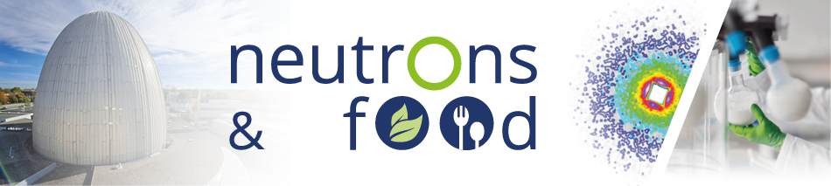


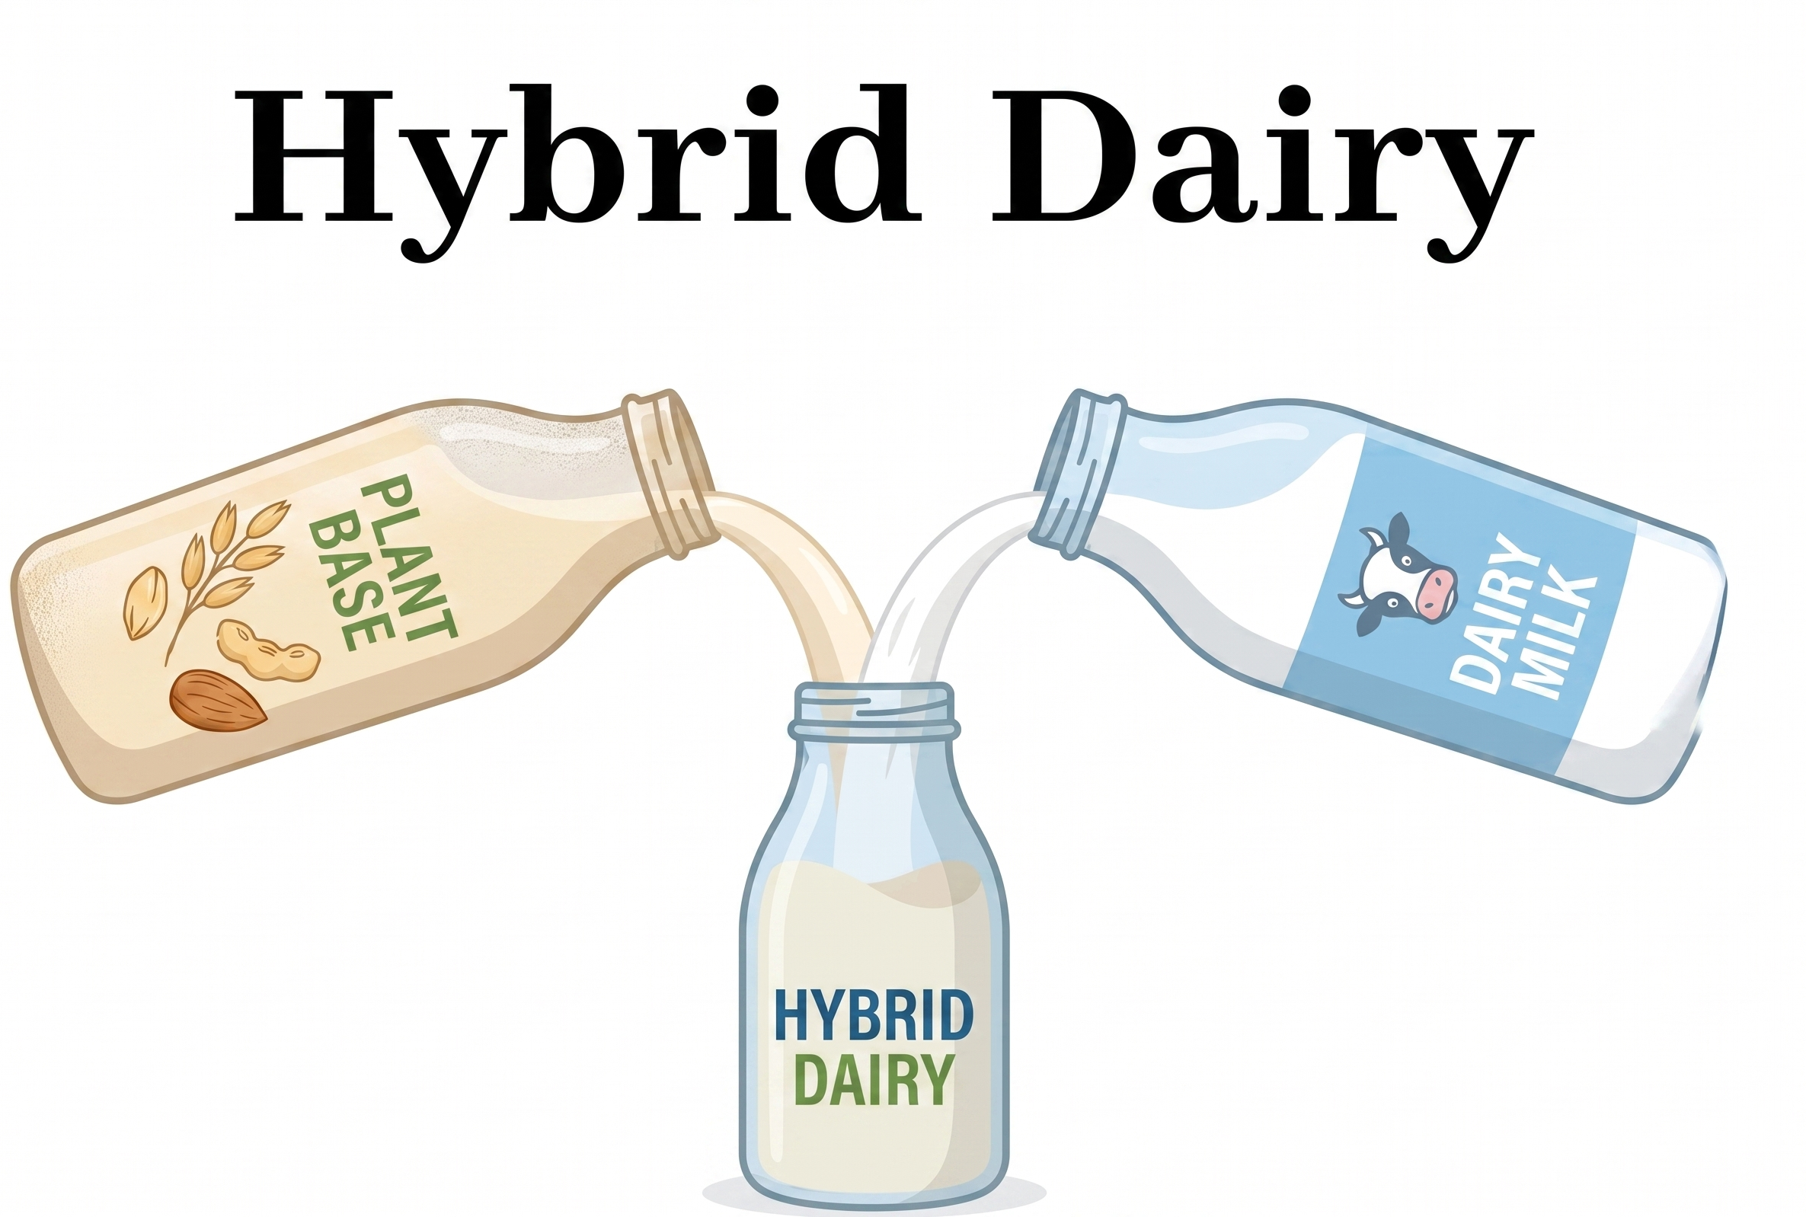
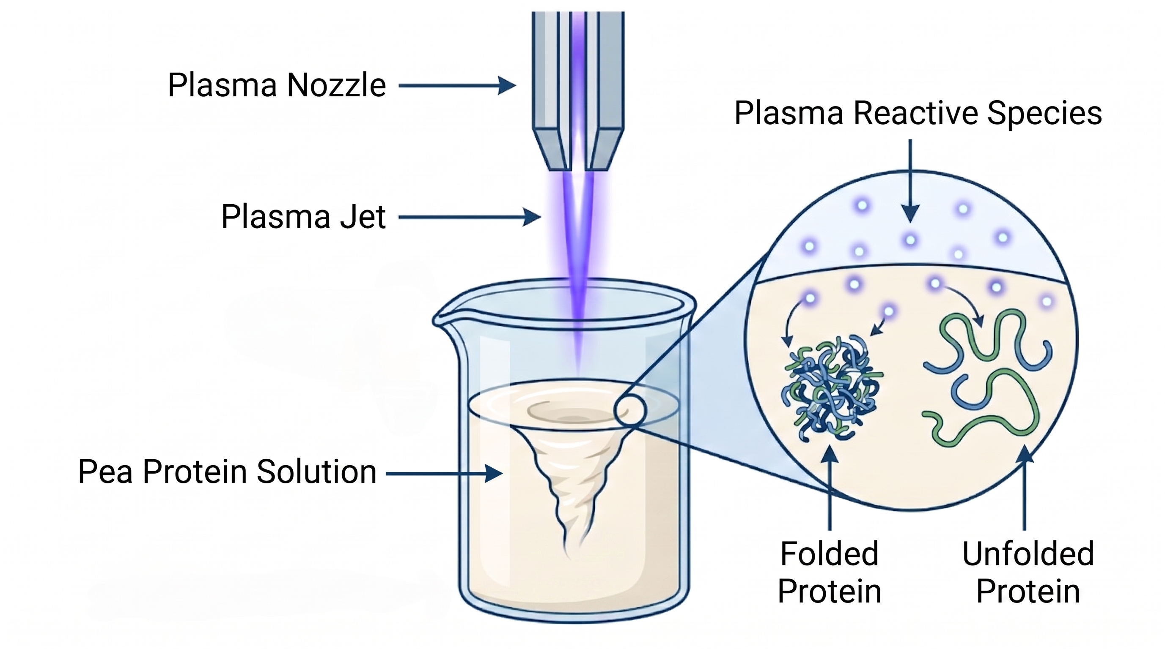
Cold Plasma Modification of Plant Protein Isolates: A Perspective for Fermented Dairy Beverages
Tuba ŞANLI¹, Muhammed FİDAN^{1*}, Canan ALTINAY¹, İlyas ATALAR², İbrahim Palabıyık³, Nevzat KONAR¹
¹Ankara University, Faculty of Agriculture, Dairy Technology Department, Ankara, Türkiye
²Eskisehir Osmangazi University, Agriculture Faculty, Food Engineering Department, Eskisehir, Türkiye
³Tekirdag Namik Kemal University, Agriculture Faculty, Food Engineering Department, Tekirdag, Türkiye
Introduction
Plant protein isolates are increasingly valued in fermented dairy beverages for their sustainability, nutritional value, and functional potential. However, legume- and oilseed-derived proteins often present challenges such as off-flavor volatile compounds and structural limitations—including low solubility, weak gel networks, and serum separation—which collectively restrict sensory acceptance and technological performance. To overcome these barriers, atmospheric cold plasma (ACP) has emerged as a promising non-thermal and chemical-free modification technology. CP treatments can effectively alter protein surface characteristics, solubility, and flavor-related volatiles. Accordingly, this study reviews the potential of CP-based modification approaches for plant protein isolates in fermented dairy systems, focusing on colloidal behavior, textural attributes, and functional performance based on current literature.
Cold Plasma Technology
Cold plasma is recognized as the fourth state of matter and has emerged as a novel, non-thermal food processing technology. Plasma is generated by supplying energy to a gas, producing a partly or completely ionized medium comprised of electrons, free radicals, ions, and UV photons. These reactive species interact with food components at low temperatures, leading to targeted structural modifications. Furthermore, CP offers distinct advantages for food applications because it is a waterless, chemical-free, and environmentally friendly process that leaves no residues. Among various generation methods, atmospheric pressure CP systems are highly suitable for the food industry, as they provide energy-efficient, rapid treatments without the need for additional vacuum conditions.
Cold plasma treatment primarily alters protein structures through the interaction of reactive species (ROS/RNS) with amino acid residues. This interaction induces mechanisms such as partial unfolding, cleavage, and the exposure of hidden hydrophobic moieties. These structural shifts directly translate into enhanced techno-functional properties (e.g., improved solubility, emulsion, and gelation) while simultaneously mitigating undesirable off-flavors, which are all critical factors for the sensory acceptance and success of hybrid dairy beverages.
Effects on Protein Properties
Sample | CP conditions | Results | Reference
Pea protein isolate | DBD-CP26 and 28 kV for 2 and 4 min | Enhanced gel strength and viscoelastic properties. Best emulsifying and foaming capacities observed at 28 kV for 2 min. | (Rout & Srivastav, 2026)
Pea protein isolate | APPJ (Atmospheric pressure plasma jet) / 1 kVA (~1 kW) for 30, 60, and 120 s | Increased water-holding capacity (max at 30 s). Increased viscosity (peaked at 60 s). Enhanced viability of Streptococcus and Lactobacillus spp. | (Şanlı et al., 2026)
Rice bean protein isolate | ACP (multipin electrode) 10–20 kV for 5–20 min | Increased solubility (from 71.95% to 88.13%), foaming capacity (from 33.3% to 300%), and emulsifying activity (from 30% to 58%), along with enhanced viscoelasticity and gel strength. | (Agarwal et al., 2026)
Hazelnut protein | ACP 2, 4, 6, and 8 min | Decreased particle size (smallest at 4–6 min), alongside increased surface hydrophobicity, emulsifying, and foaming stability (highest at 6 min). | (Uzun, 2026)
Sunflower seed protein | DBD-CP 50 W for 1-5 min | Increased solubility (highest at 3 min), zeta-potential, and surface hydrophobicity, along with enhanced emulsifying activity and stability (peaked at 2-3 min). | (Wang et al., 2024)
Pea protein isolate | ACP (pin-to-plate) /170–230 V (55.63 kHz) for 5–15 min | Increased soluble protein (by 66.94%), foaming capacity (by 57.28%), emulsifying activity (by 25.27%), and viscosity during cooling. | (Acharjee et al., 2023)
Soy protein isolate | ACP with DBD 50 kV 75 Hz for 180 s | Solubility, gelling, emulsion activity, emulsion stability and foam capacity increased by 25, 13, 50, 110, and 25%. | (Li et al., 2023)
Conclusion & Future Perspectives
Atmospheric cold plasma offers a promising non-thermal approach to address the structural and sensory limitations of plant protein isolates. By inducing surface modifications and partial unfolding, CP can improve techno-functional properties such as solubility and gelation while aiding in the reduction of off-flavor volatiles. These modifications demonstrate potential for incorporating plant proteins into fermented dairy systems. However, the industrial adoption of this technology requires further optimization of processing parameters based on specific protein sources. Moving forward, future studies should primarily focus on scaling up the plasma systems for continuous liquid processing, alongside comprehensive sensory evaluations and shelf-life assessments of the final products.
References & Acknowledgements
*The participation in this scientific event is financially supported by The Scientific and Technological Research Council of Türkiye (TÜBİTAK) under the 2224-A Support Program for Participation in Scientific Events Abroad.
Şanlı, T., Altınay, C., Atalar, İ., Fidan, M., Öztürk, N. Z., Palabıyık, İ., & Konar, N. (2026). Cold‐plasma‐induced modification of pea protein isolate: implications for functional and physicochemical enhancement in hybrid fermented dairy beverages. Journal of the Science of Food and Agriculture.
Oner, M. E., Subasi, B. G., Ozkan, G., Esatbeyoglu, T., & Capanoglu, E. (2023). Efficacy of cold plasma technology on the constituents of plant-based food products: Principles, current applications, and future potentials. Food Research International, 172, 113079.
Rout, S., & Srivastav, P. P. (2026). Enhancing the Rheological, Thermal, and Physicochemical Properties of Pea Protein Isolate via Dielectric Barrier Discharge Cold Plasma Treatment. Journal of Food Process Engineering, 49(4), e70509.
Agarwal, C., Sehrawat, R., Sharma, L., & Patel, M. K. (2026). Unveiling the effects of cold plasma treatment on the structural, rheological, and functional properties of rice bean protein isolate. Sustainable Food Technology.
Uzun, S. (2026). Structural and Functional Modifications of Hazelnut Proteins Induced by Atmospheric Cold Plasma. Polymers, 18(3), 413.
Wang, P., Wang, Y., Du, J., Han, C., & Yu, D. (2024). Effect of cold plasma treatment of sunflower seed protein modification on its structural and functional properties and its mechanism. Food Hydrocolloids, 155, 110175.
Acharjee, A., Dabade, A., Kahar, S., & Annapure, U. (2023). Effect of atmospheric pressure non-thermal pin to plate cold plasma on structural and functional properties of pea protein isolate. Journal of Agriculture and Food Research, 14, 100821.
Li, Q., Shen, F., He, X., Xing, C., Yan, W., Fang, Y., & Hu, Q. (2023). Modification of soy protein isolate using dielectric barrier discharge cold plasma assisted by modified atmosphere packaging. Food Chemistry, 401, 134158.

