Slide 1
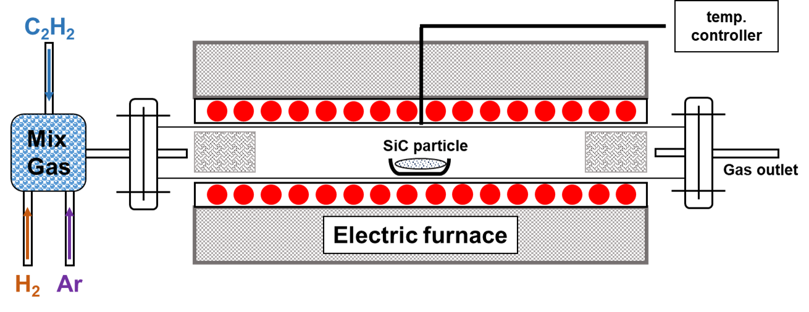
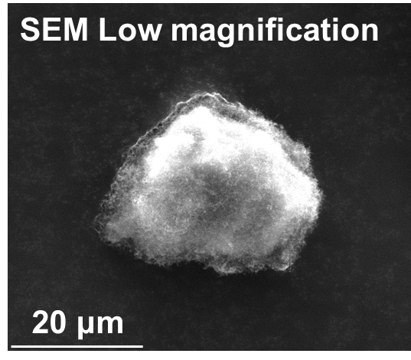
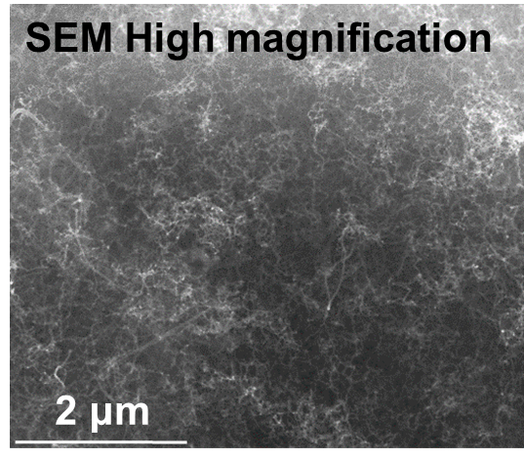
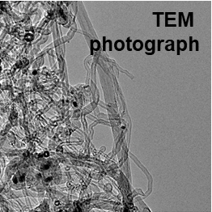
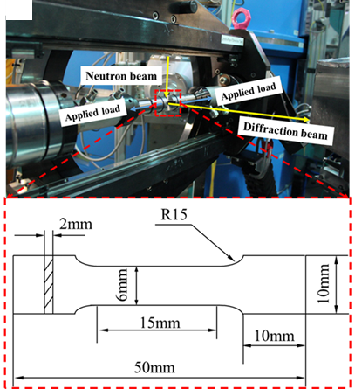
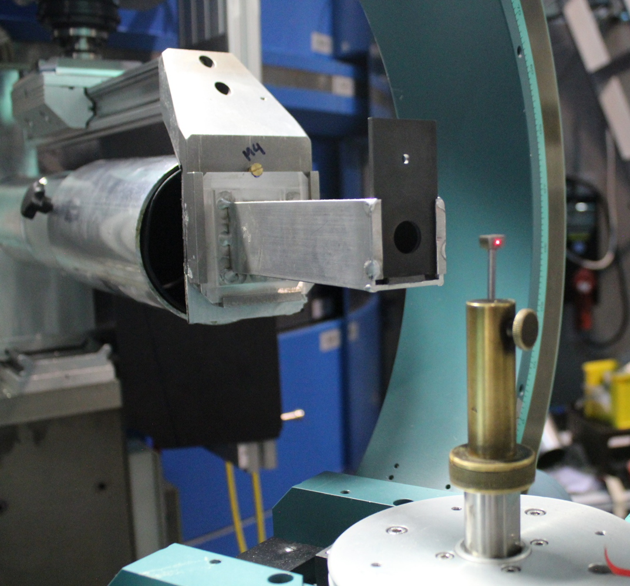
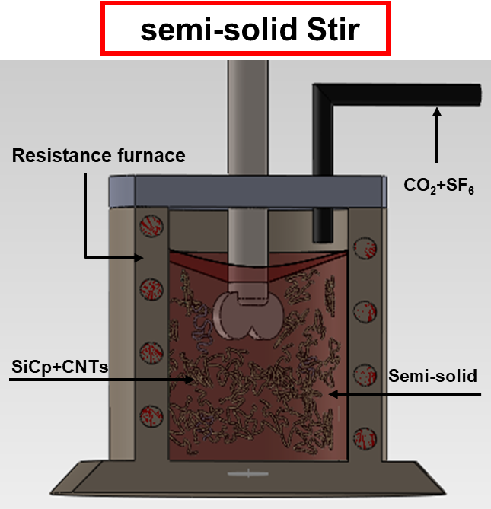
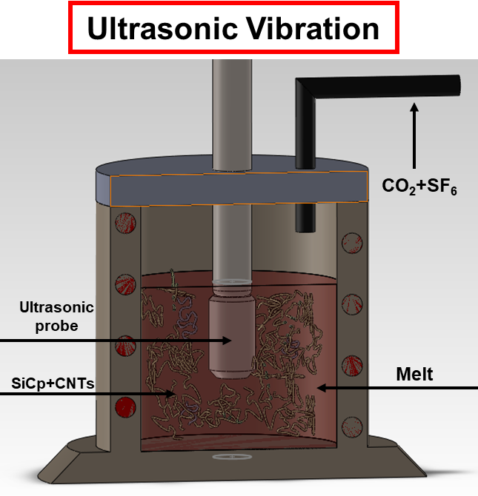
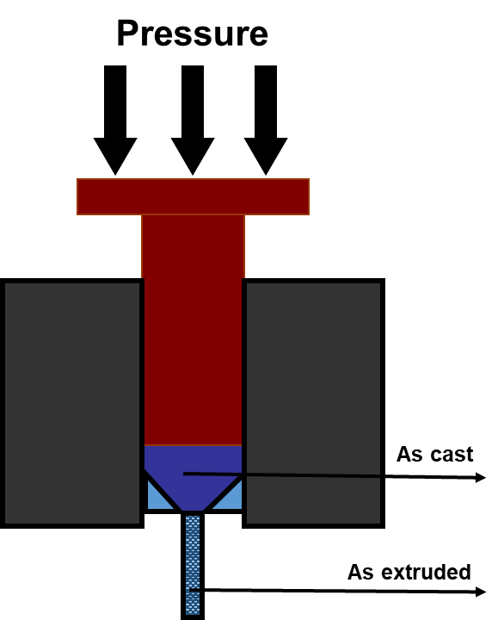
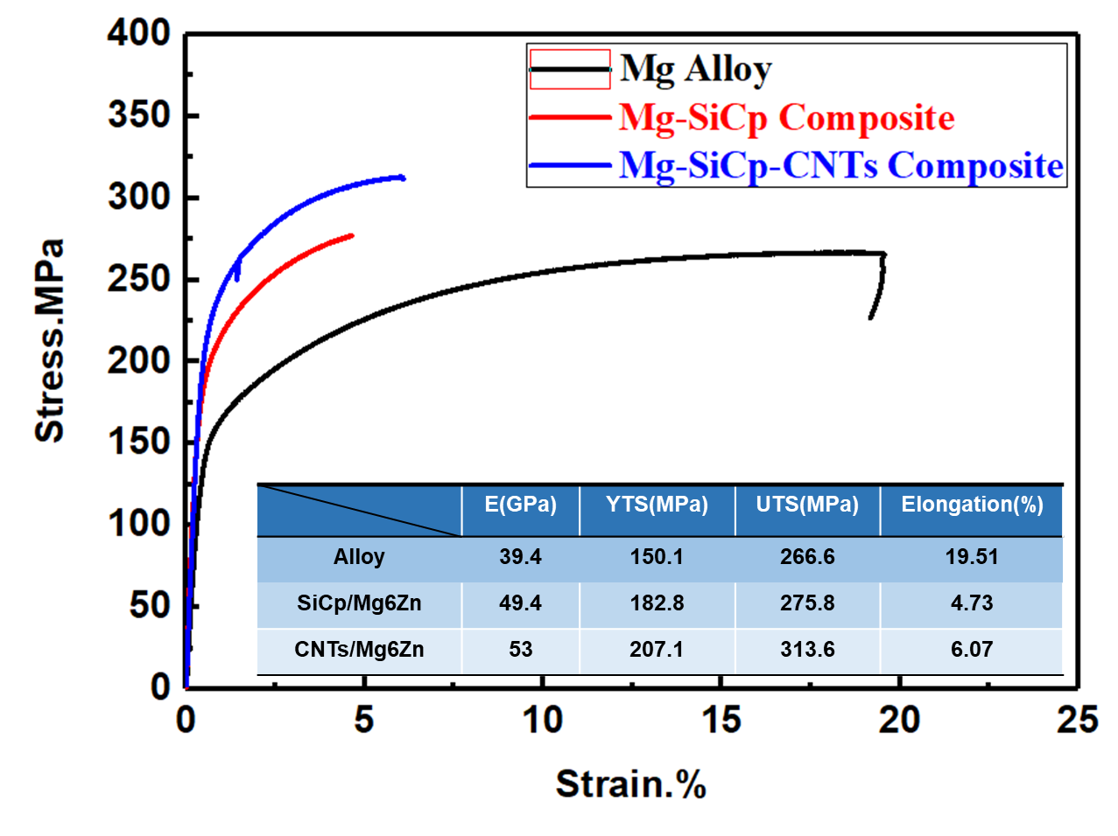
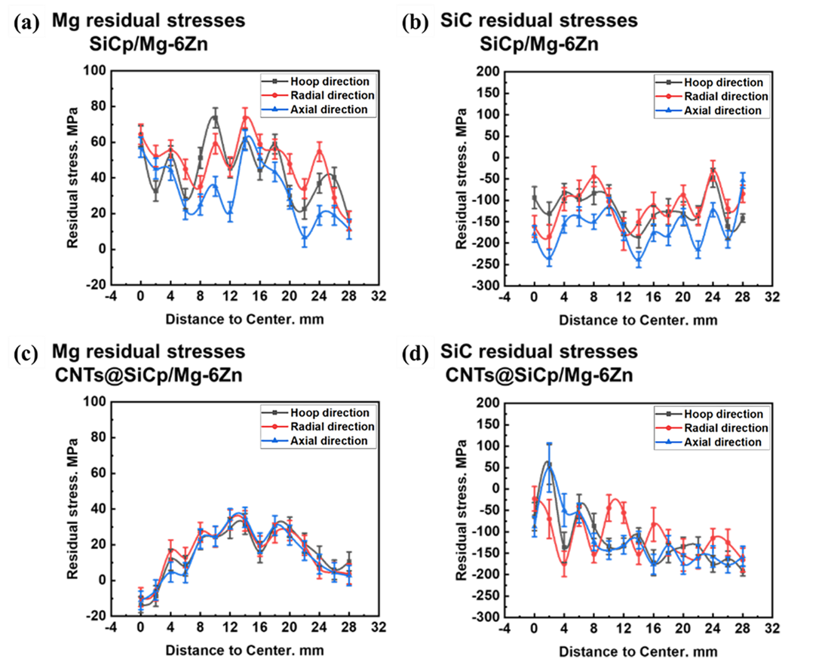
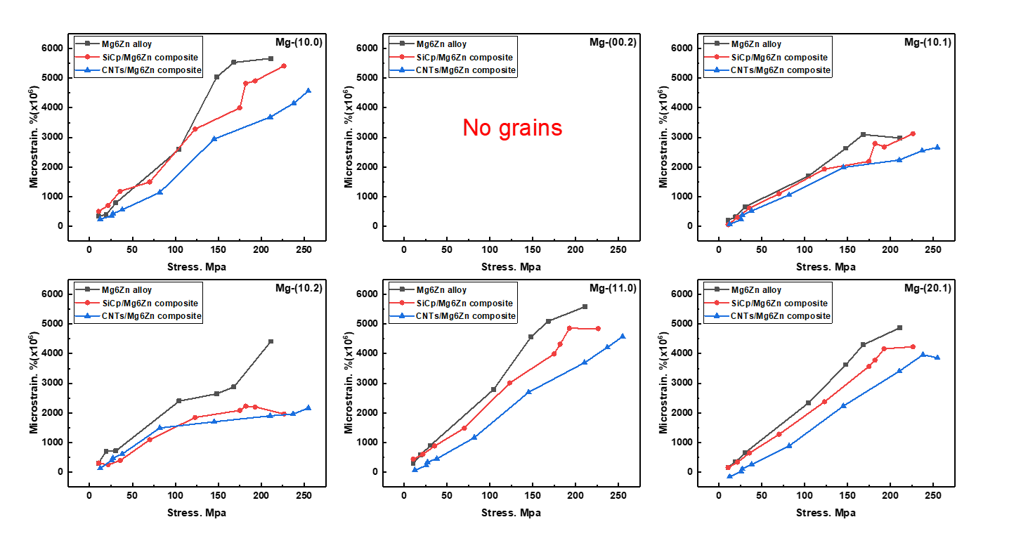
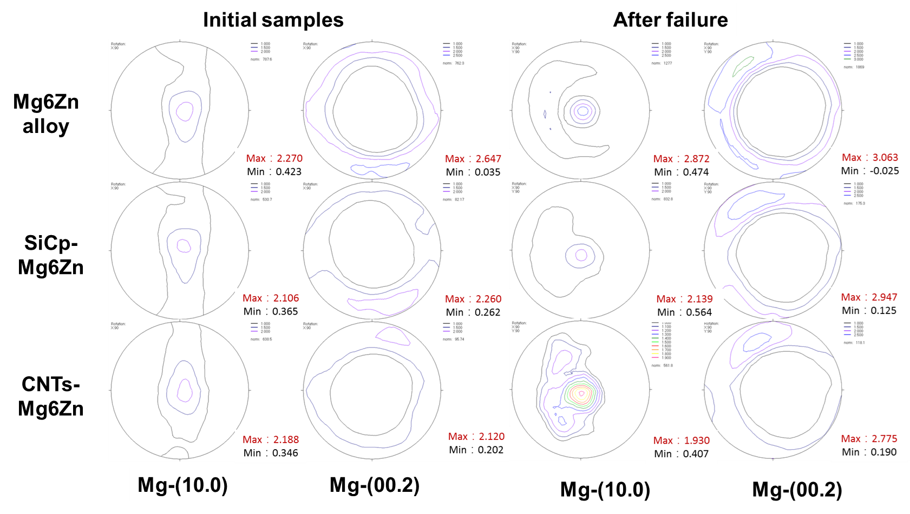
Microstructure and in-situ tensile behavior of CNTs reinforced
Mg composites using neutron diffraction
C. Ding^{1,2}, W.T. Du^{1,2}, W.M. Gan³, M. Hofmann⁴
¹Institute of High Energy Physics, Chinese Academy of Science, Beijing, China
²Spallation neutron source science center, Dongguan, Guangdong, China
³Institute of Materials Physics, Helmholtz-Zentrum Hereon, Geesthacht, Germany
⁴Heinz Maier-Leibnitz (FRM II), Technische Universität München, Garching, Germany
Introduction
Hybrid Mg MMCs, reinforced with SiCp and CNTs, have shown superior tensile properties, which is mainly attributed to the addition of CNTs to SiCp with CVD method. A brief introduction on a novel fabrication process of the CNTs reinforced Mg-Zn matrix composites is presented.
The characterizations of their microstructures and phase by lab X-ray and In-situ tensile deformation test of these composites was performed using neutron diffraction at STRESS-SPEC (MLZ, Garching). Bulk texture of both the initial and the tensile to broken samples was also investigated ex-situ by neutron diffraction.
Experimental Procedure
1. CNTs@SiCp synthesis
3. Residual stresses measurement
4. In-situ tension and pole figure measurement
2. Composites fabrication
Result & Discussion
Mechanical properties
Residual stresses in materails
Evolution of lattice strain
Pole figure of extruded materials
Summary
CNTs were synthesized on SiCp surface by CVD method, and hybrid Mg composites were fabricated by semi-solid stirring.
The residual stress of Mg in CNTs@SiCp/Mg-6Zn is less than half of that in SiCp/Mg-6Zn composite.
After SiCp and CNTs addition, a torpid decrease of crystal faces lattice strain occurs during tensile process.
The measured pole figures indicated no obvious change of the samples with the addition of CNTs.

